Slide 1
Chapter 11:
File-System Implementation

Slide 2
Chapter 11:
File-System Implementation
11.1 File-System Structure
11.4 Allocation Methods
11.5 Free-Space Management
11.7 Recovery
11.10 Summary

Slide 3
Objectives
To describe the details of implementing local file systems and directory structures.
To describe the implementation of remote file systems.
To discuss block allocation and free-block algorithms and trade-offs.

Slide 4
File-System Structure
11.1
Overview
File structure:
  Logical storage unit.
  Collection of related information.
File system resides on secondary storage (disks)
  Provided user interface to storage, mapping logical to physical.
  Provides efficient and convenient access to disk by allowing data to be stored, located retrieved easily.

Slide 5
File-System Structure
11.1
Disk provides in-place rewrite and random access:
  I/O transfers performed in blocks of sectors (usually 512 bytes).
File control block – storage structure consisting of information about a file.
Device driver controls the physical device.
File system organized into layers (next slide).

Slide 6
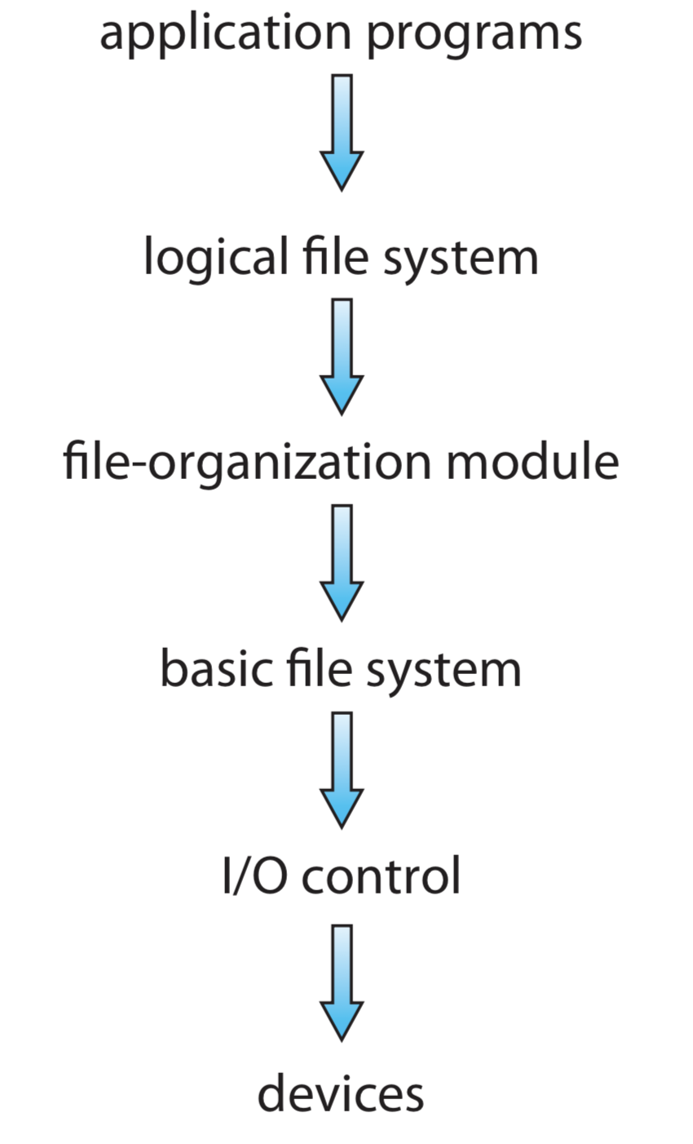
File-System Structure
11.1
Logical file system → manages metadata information includes all the file-system structure, except the actual data.
  File-organization module → understands files, logical address, and physical blocks.
Basic file system → to issue generic commands to the appropriate device driver to read/write physical blocks on the disk.
I/O control → consists of device drivers and interrupt handlers to transfer information between main memory and the disk system.
Figure 11.1 Layered file system.

Slide 7
File-System Structure
11.1
  File-organization module → understands files, logical address, and physical blocks.
  Translates logical block # to physical block #
  Manages disk allocation and free space.
Figure 11.1 Layered file system.

Slide 8
11.4
Allocation Methods
Overview
A disk is a direct-access device and thus gives us flexibility in the implementation of files.
The main issue is :
  how to allocate space to these files so that disk space is utilized effectively, and
  files can be accessed quickly.
An allocation method refers to how disk blocks are allocated for files.

Slide 9
11.4
Allocation Methods
Three major methods of allocating disk space are in wide:
Methods
Linked
Contiguous
Indexed
Linked Scheme
Multilevel Index
Combined Scheme
Extent-based system
Index Block Structure

Slide 10
11.4
Allocation Methods
(a) Contiguous allocation
Each file occupies a set of contiguous blocks.
Best performance in most cases.
Simple – only starting location (block #) and length (number of blocks) are required.
Problems include:
  Finding space for file,
  Difficult file extension,
  Knowing file size (max size),
  External fragmentation,
  Need for compaction.

Slide 11
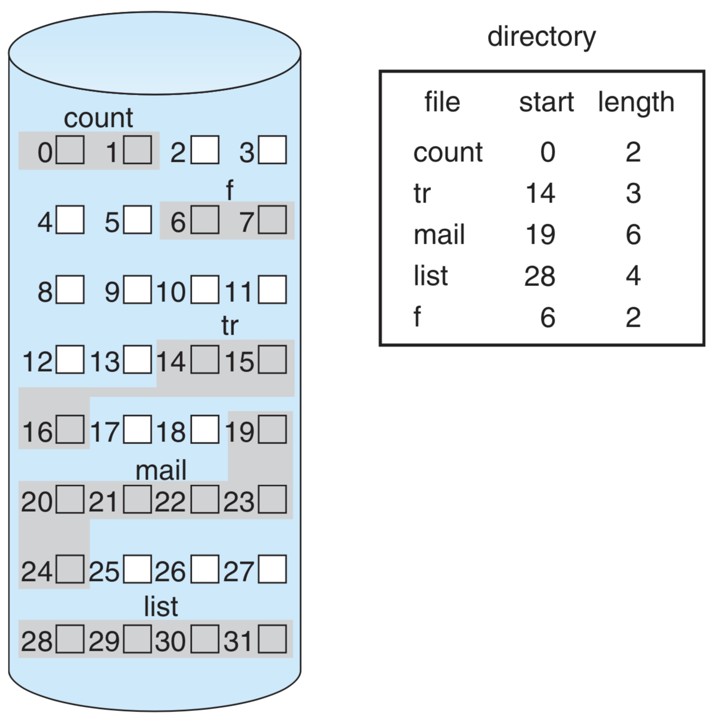
11.4
Allocation Methods
Example 1 :
(Page: 506)
Mapping from logical to physical.
Figure 11.5 Contiguous allocation of disk space.

Slide 12
11.4
Allocation Methods
Example 2 :
Contiguous file storage for File A and B.
Slot: 0 1 2 3 4 5 6 7 8 9 10 11
File A:
This file cannot be expanded for new record.
Solution: rewrite into a larger storage area.
File B:
This file can be expanded by only one record that replacing the free space at slot 10.

Slide 13
11.4
Allocation Methods
Extent-based systems
A file will grow slowly over a long period (months or years) must be allocated enough space for its final size, even though much of the spaces will be unused for a long time → internal fragmentation.
Solution: Modified Contiguous-Allocation scheme.
  A contiguous block of space is allocated initially.
  If not enough, another contiguous block, known as extent, is added.
  A file may consists of one or more extent blocks.

Slide 14
11.4
Allocation Methods
(b) Linked allocation
Each file is a linked list of blocks.
No external fragmentation.
Each block contains pointer to next block.
Free space management system called when new block needed.

Slide 15
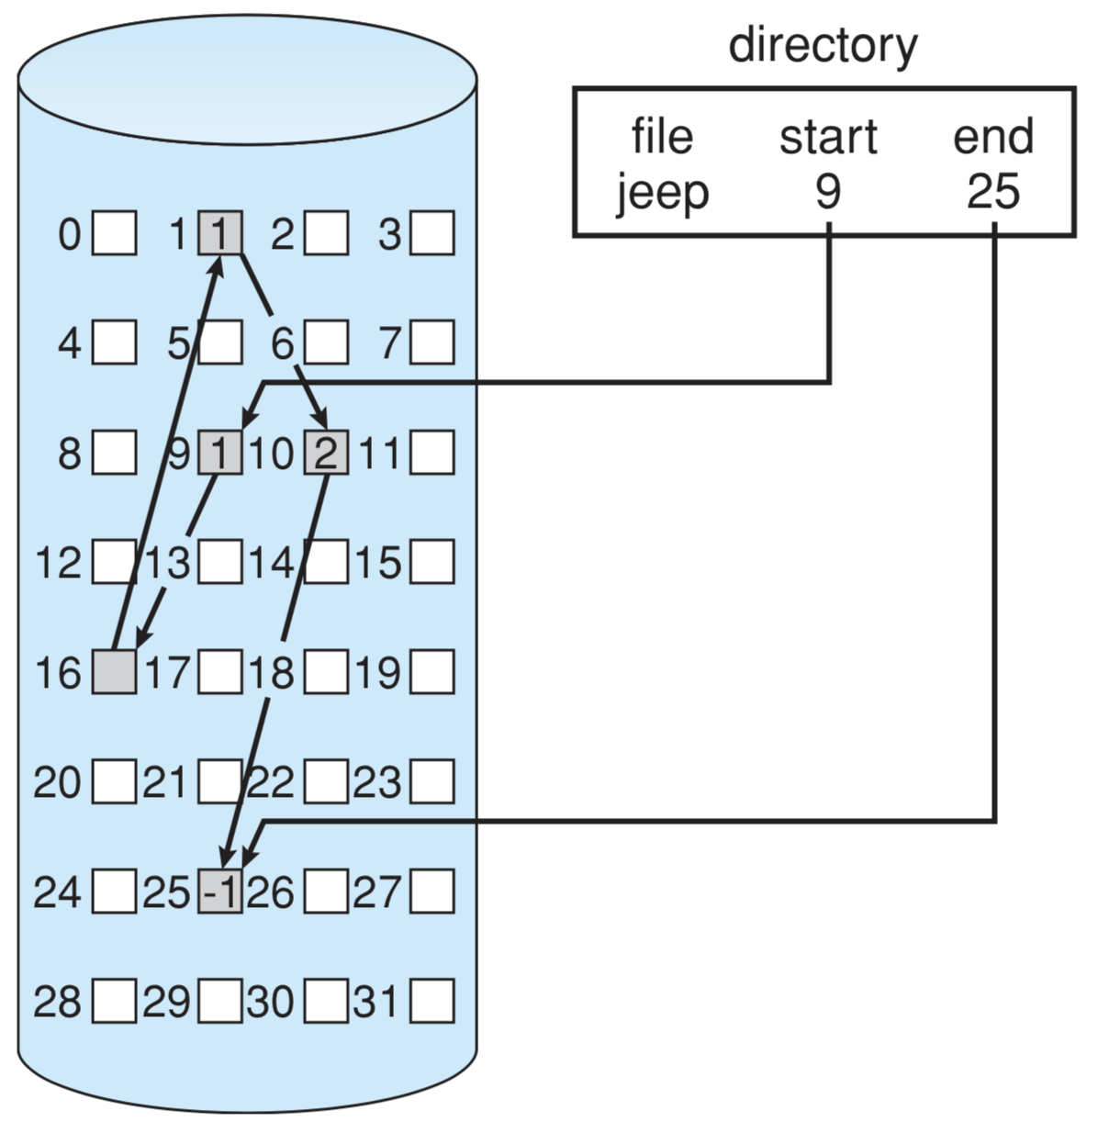
11.4
Allocation Methods
Example 3 :
(Page: 508)
10
A file of five blocks start at blocks 9 and continue at block 16, then block 1, then block 10, and finally block 25.
Each block contains a pointer to the next block.
16
25
1
−
Figure 11.6 Linked allocation of disk space.

Slide 16
11.4
Allocation Methods
Example 4 :
A linked allocation with File A starts at block 2 and continues at block 8, 20, and 18.
Each block includes its address and a pointer to the next block of the file as well as the data itself.
1
2
8
3
6
2
3
4
5
6
11
8
20
6
7
8
9
10
11
-
11
12
Directory Entry
13
14
15
16
File No. | Start | End | No. Extents
A | 2 | 18 | 3
B | 3 | 11 | 2
File No. | Start | End | No. Extents
A | 2 | 18 | 3
B | 3 | 11 | 2
File No. | Start | End | No. Extents
A | 2 | 18 | 3
B | 3 | 11 | 2
17
18
-
20
18
18
19
20

Slide 17
11.4
Allocation Methods
Example 3 and 4 are a sequential-access files.
To find the i-th block of a file, it starts at the beginning of that file and follow the pointers until the block.
Disadvantages:
Locating a block can take many I/Os and disk seeks.
Reliability can be a problem (what if one of the pointers get corrupted?)
Solution: File-Allocation Table (FAT)
Beginning of volume has table, indexed by block number.
Much like a linked list, but faster on disk and cacheable.
New block allocation simple.

Slide 18
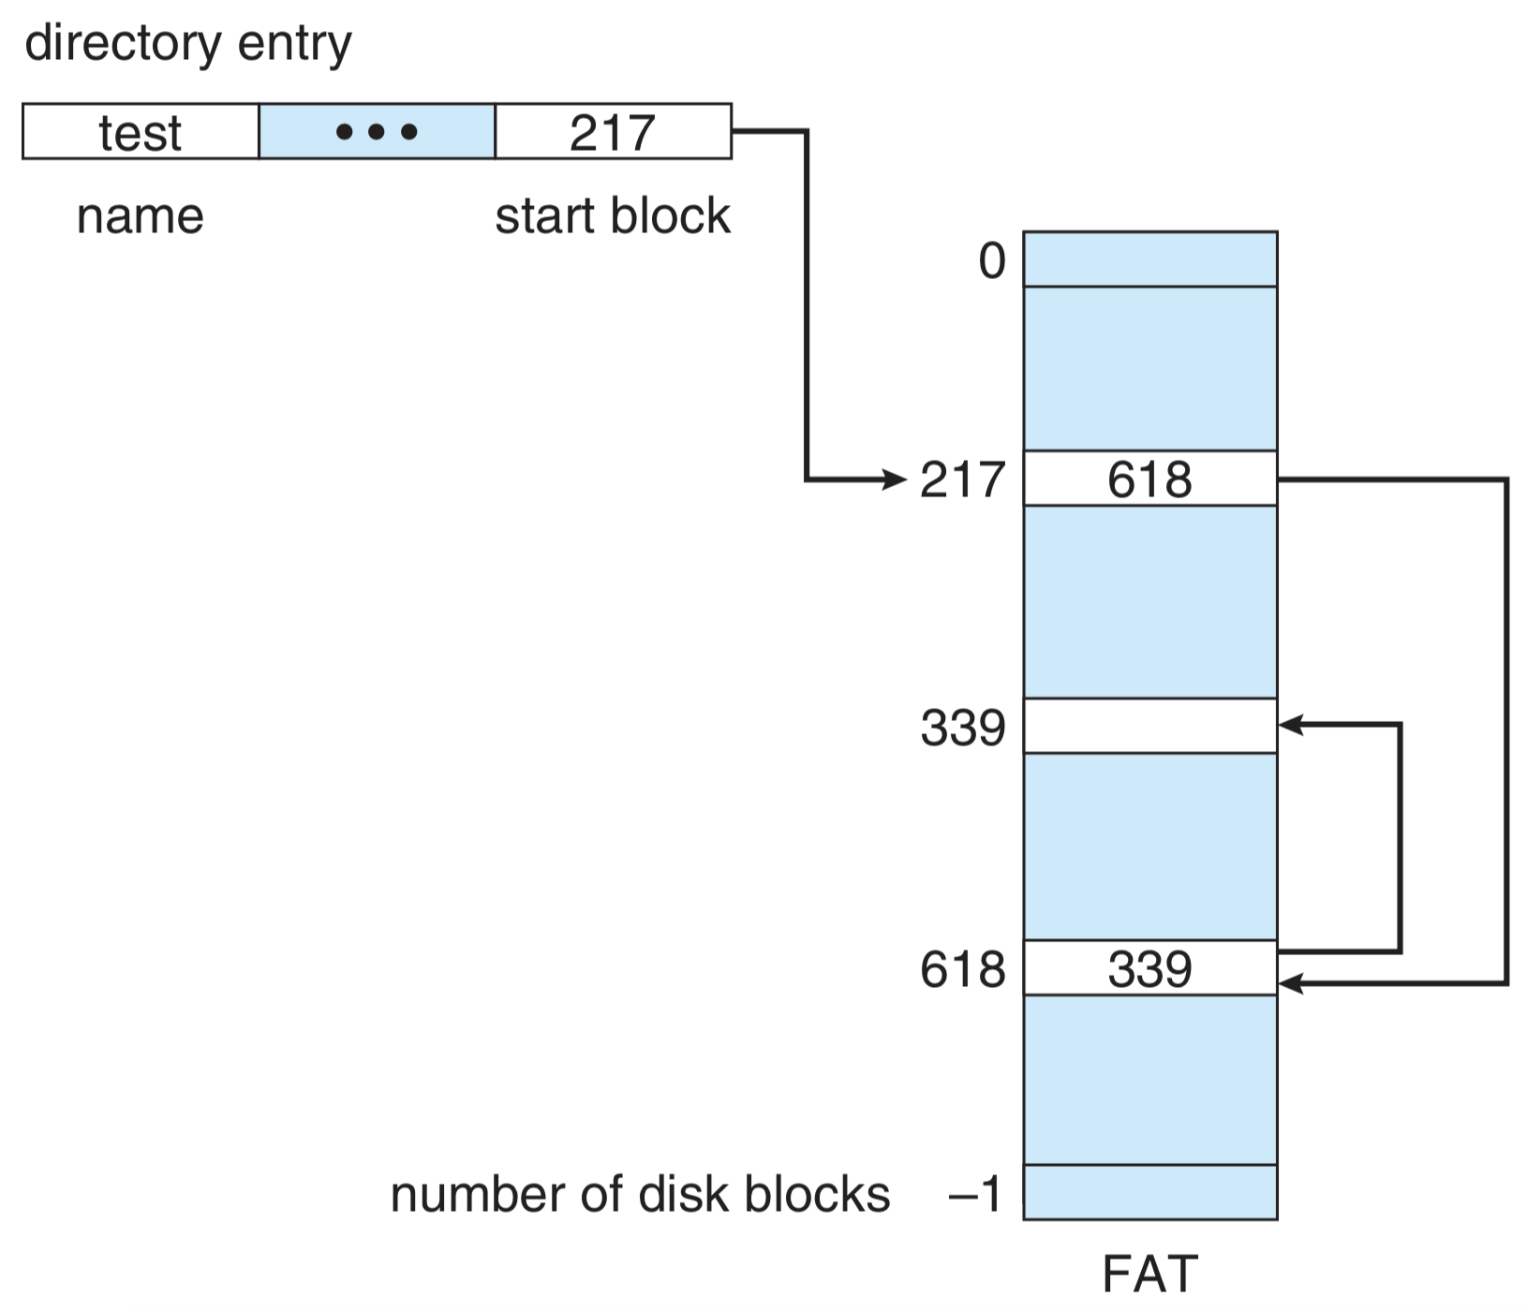
11.4
Allocation Methods
Example 5 :
(Page: 510)
FAT structure for a file ‘test’ consisting of disk blocks 217, 618, and 339.
Figure 11.7 File-Allocation Table (FAT).

Slide 19
11.4
Allocation Methods
Example 6a :
Directory Entry
File | Address | Size (KB) | Next
 | 1 | 512
File A (1) | 2 | 512 | 8
File B (1) | 3 | 512 | 6
 | . . . | . . .
File B (2) | 6 | 512 | 11
 | 7 | 512
File A (2) | 8 | 512 | 20
 | . . . | . . .
File B (3) | 11 | 512 | -
 | . . . | . . .
File A (4) | 18 | 512 | -
 | 19 | 512
File A (3) | 20 | 512 | 18
File | Address | Size (KB) | Next
 | 1 | 512
File A (1) | 2 | 512 | 8
File B (1) | 3 | 512 | 6
 | . . . | . . .
File B (2) | 6 | 512 | 11
 | 7 | 512
File A (2) | 8 | 512 | 20
 | . . . | . . .
File B (3) | 11 | 512 | -
 | . . . | . . .
File A (4) | 18 | 512 | -
 | 19 | 512
File A (3) | 20 | 512 | 18
File | Address | Size (KB) | Next
 | 1 | 512
File A (1) | 2 | 512 | 8
File B (1) | 3 | 512 | 6
 | . . . | . . .
File B (2) | 6 | 512 | 11
 | 7 | 512
File A (2) | 8 | 512 | 20
 | . . . | . . .
File B (3) | 11 | 512 | -
 | . . . | . . .
File A (4) | 18 | 512 | -
 | 19 | 512
File A (3) | 20 | 512 | 18
File | Address | Size (KB) | Next
 | 1 | 512
File A (1) | 2 | 512 | 8
File B (1) | 3 | 512 | 6
 | . . . | . . .
File B (2) | 6 | 512 | 11
 | 7 | 512
File A (2) | 8 | 512 | 20
 | . . . | . . .
File B (3) | 11 | 512 | -
 | . . . | . . .
File A (4) | 18 | 512 | -
 | 19 | 512
File A (3) | 20 | 512 | 18
File | Address | Size (KB) | Next
 | 1 | 512
File A (1) | 2 | 512 | 8
File B (1) | 3 | 512 | 6
 | . . . | . . .
File B (2) | 6 | 512 | 11
 | 7 | 512
File A (2) | 8 | 512 | 20
 | . . . | . . .
File B (3) | 11 | 512 | -
 | . . . | . . .
File A (4) | 18 | 512 | -
 | 19 | 512
File A (3) | 20 | 512 | 18
MS-DOS which uses linked allocation - FAT.
1
(1)
2
3
4
5
6
7
(2)
8
9
10
11
12
13
14
15
16
17
(4)
18
19
(3)
20

Slide 20
11.4
Allocation Methods
Example 6b :
Directory Entry
File | Address | Size (KB) | Next
 | 1 | 512
File A (1) | 2 | 512 | 8
File B (1) | 3 | 512 | 6
 | . . . | . . .
File B (2) | 6 | 512 | 11
 | 7 | 512
File A (2) | 8 | 512 | 20
 | . . . | . . .
File B (3) | 11 | 512 | -
 | . . . | . . .
File A (4) | 18 | 512 | -
 | 19 | 512
File A (3) | 20 | 512 | 18
File | Address | Size (KB) | Next
 | 1 | 512
File A (1) | 2 | 512 | 8
File B (1) | 3 | 512 | 6
 | . . . | . . .
File B (2) | 6 | 512 | 11
 | 7 | 512
File A (2) | 8 | 512 | 20
 | . . . | . . .
File B (3) | 11 | 512 | -
 | . . . | . . .
File A (4) | 18 | 512 | -
 | 19 | 512
File A (3) | 20 | 512 | 18
File | Address | Size (KB) | Next
 | 1 | 512
File A (1) | 2 | 512 | 8
File B (1) | 3 | 512 | 6
 | . . . | . . .
File B (2) | 6 | 512 | 11
 | 7 | 512
File A (2) | 8 | 512 | 20
 | . . . | . . .
File B (3) | 11 | 512 | -
 | . . . | . . .
File A (4) | 18 | 512 | -
 | 19 | 512
File A (3) | 20 | 512 | 18
File | Address | Size (KB) | Next
 | 1 | 512
File A (1) | 2 | 512 | 8
File B (1) | 3 | 512 | 6
 | . . . | . . .
File B (2) | 6 | 512 | 11
 | 7 | 512
File A (2) | 8 | 512 | 20
 | . . . | . . .
File B (3) | 11 | 512 | -
 | . . . | . . .
File A (4) | 18 | 512 | -
 | 19 | 512
File A (3) | 20 | 512 | 18
MS-DOS which uses linked allocation - FAT.
1
2
(1)
3
4
5
(2)
6
7
8
9
10
(3)
11
12
13
14
15
16
17
18
19
20

Slide 21
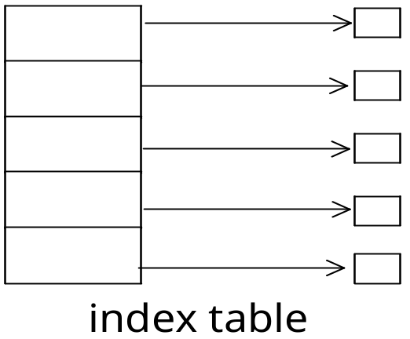
11.4
Allocation Methods
(c) Indexed allocation
Each file has its own index block(s) of pointers to its data blocks.
Logical view:
Need index table.
Random access.
Dynamic access without external fragmentation, but have overhead of index block.

Slide 22
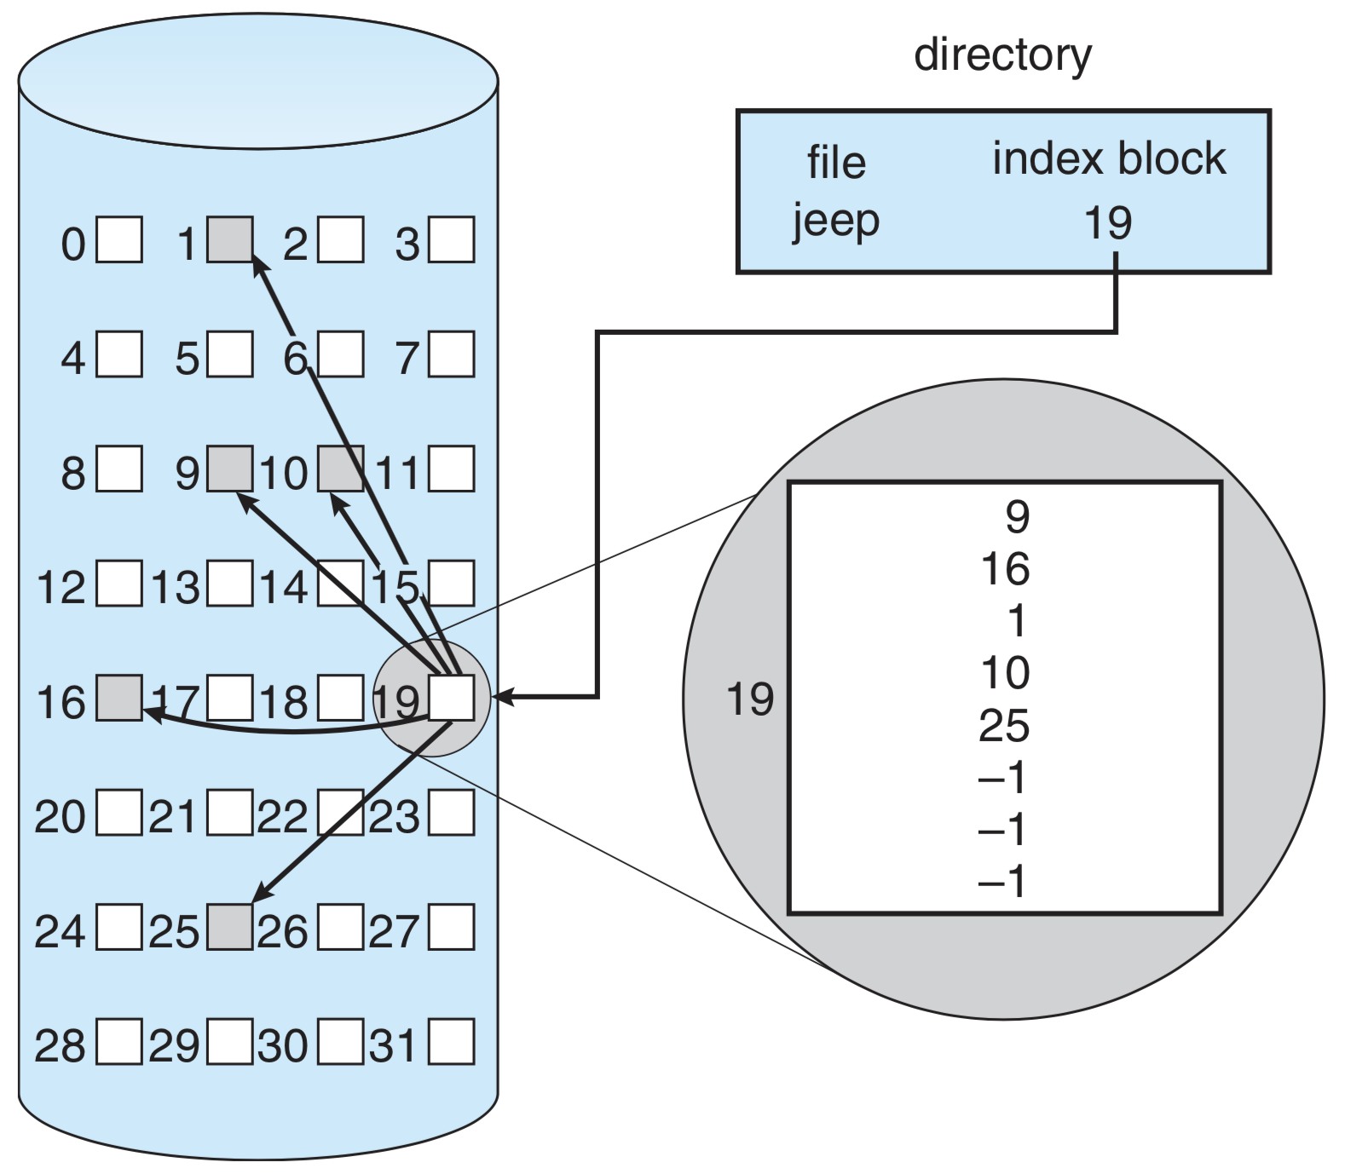
11.4
Allocation Methods
Example 7 :
(Page: 510)
The directory contains the address of the index block.
To find and read the ith block, the pointer in the ith index-block entry is used.
9
16
1
10
25
−1
−1
−1
Figure 11.8 Example of Indexed Allocation. Assume each block can only stores 8 block addresses.

Slide 23
11.4
Allocation Methods
Example 8a :
Indexed allocation for 4 bytes each block.
1
2
2
3
3
4
5
6
7
8
8
9
10
11
12
2
8
20
18
12
13
14
15
16
File No. | Index Block
1 | 12
2 | 4
File No. | Index Block
1 | 12
2 | 4
17
18
18
19
20
20
20

Slide 24
11.4
Allocation Methods
Example 8b :
Indexed allocation for 4 bytes each block.
3
6
11
−1
1
2
4
2
3
3
4
5
6
6
7
8
9
10
11
11
12
13
14
15
16
File No. | Index Block
1 | 12
2 | 4
17
18
19
20
20

Slide 25
Index Block Size Dilemma
11.4
Allocation Methods
If the index block is:
  small → it will not be able to hold enough pointers for large files.
  large → there may be lots of unused space if the file size is small.
9
16
1
10
25
−1
−1
−1
−1
−1
−1
Solution:
Use index block structure

Slide 26
11.4
Allocation Methods
Index Block Structure
Linked scheme
Multilevel index
Combined scheme

Slide 27
Indexed Allocation: (1) Linked scheme
11.4
Allocation Methods
Example 9 :
File blocks → 9, 12, 5, 3, 4, 7, 19, 16.
Assume each block can only stores 5 block addresses.
File blocks → 9, 12, 5, 3, 4, 7, 19, 16.
File blocks → 9, 12, 5, 3, 4, 7, 19, 16.
12
5
3
4
7
19
16
−
−
−
12
5
3
4
7
Directory:
File Index Block
DATA 9
Block 9
Block 7

Slide 28
Indexed Allocation: (2) Multilevel index
11.4
Allocation Methods
Example 10 :
Two-level index.

outer-index
index table
file

Slide 29
11.4
Allocation Methods
Example 11 :
Multilevel index.
Directory
3rd-level
inode
First-level inode
Index block
Data block
2nd-level
inode
Files

Slide 30
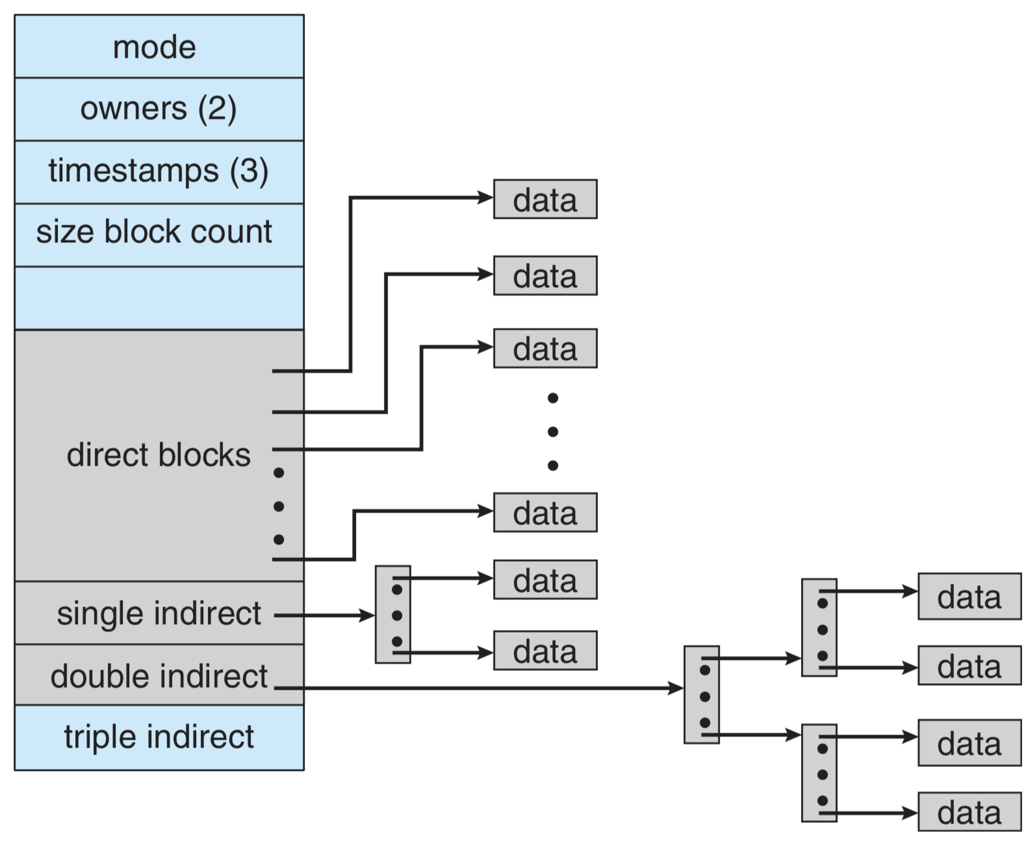
Indexed Allocation: (3) Combined scheme
11.4
Allocation Methods
Example 12 :
The UNIX File System (UFS).
4K bytes per block, 32-bit addresses.

Slide 31
11.4
Allocation Methods
Performance
Best method depends on file access type.
  Contiguous great for sequential and random.
Linked good for sequential, not for random.
Declare access type at creation → select either contiguous or linked.
Indexed more complex.
  Single block access could require 2 index block reads then data block read.

Slide 32
Free-Space Management
11.5
Overview
Since disk space is limited, we need to reuse the space from deleted files for new files, if possible.
File system maintains free-space list to track available blocks / clusters.
  (Using term “block” for simplicity)
4 Techniques
Free / Linked List
Bit / Vector map
Grouping
Counting

Slide 33
11.5
Free-Space Management
(a) Bit map
Bit map or bit vector (n blocks)
0
1
2
n−1
…
1 → block [i] is free
0 → block [i] is used
bit[i] =
The calculation of the first free block number.
  → The first non-0 word is scanned for the first 1 bit, which is the location of the first free block.

Slide 34
11.5
Free-Space Management
Example 13 :
Assume there are 8 bits per word and the bit map is as follows:
Block No. | 0 | 1 | 2 | 3 | 4 | 5 | 6 | 7 | 8 | 9 | 10 | 11 | 12 | 13 | 14 | 15 | 16
Bit map : | 0 | 0 | 0 | 0 | 0 | 0 | 0 | 0 | 0 | 0 | 0 | 0 | 1 | 0 | 1 | 0 | 1 | …
Offset : | 0 | 1 | 2 | 3 | 4 | 5 | 6 | 7 | 0 | 1 | 2 | 3 | 4 | 5 | 6 | 7 | 0 | …
Block No. | 0 | 1 | 2 | 3 | 4 | 5 | 6 | 7 | 8 | 9 | 10 | 11 | 12 | 13 | 14 | 15 | 16
Bit map : | 0 | 0 | 0 | 0 | 0 | 0 | 0 | 0 | 0 | 0 | 0 | 0 | 1 | 0 | 1 | 0 | 1 | …
Offset : | 0 | 1 | 2 | 3 | 4 | 5 | 6 | 7 | 0 | 1 | 2 | 3 | 4 | 5 | 6 | 7 | 0 | …
Block No. | 0 | 1 | 2 | 3 | 4 | 5 | 6 | 7 | 8 | 9 | 10 | 11 | 12 | 13 | 14 | 15 | 16
Bit map : | 0 | 0 | 0 | 0 | 0 | 0 | 0 | 0 | 0 | 0 | 0 | 0 | 1 | 0 | 1 | 0 | 1 | …
Offset : | 0 | 1 | 2 | 3 | 4 | 5 | 6 | 7 | 0 | 1 | 2 | 3 | 4 | 5 | 6 | 7 | 0 | …
A word
First free block
To find the address of the first free block
= (number of bits per word ) * (number of 0-value words) +
offset of first 1 bit
= (8 * 1) + 4 = 12

Slide 35
11.4
Allocation Methods
Exercise 11.1 :
Given a bit map value (0 → used; 1 → unused/free).
Block No.:
0
1
2
3
4
5
6
7
8
9
10
11
12
13
14
15
…
1 KB
1 KB
1 KB
1 KB
1 KB
Bit Map:
0
0
1
1
0
0
0
0
1
0
1
0
1
0
1
0
…
List the block addresses
needed by a file with
size 5KB for the
different block size of
file system.
Case(s) | Block size | Address(es)
1 | 1 KB
2 | 2 KB
3 | 3 KB
4 | 5 KB
5 | 0.5 KB
1
2, 3, 8, 10, 12
2
2, 3, 8
2, 3
2
2, 3, 8, 10, 12, 14,
Another 4 addresses

Slide 36
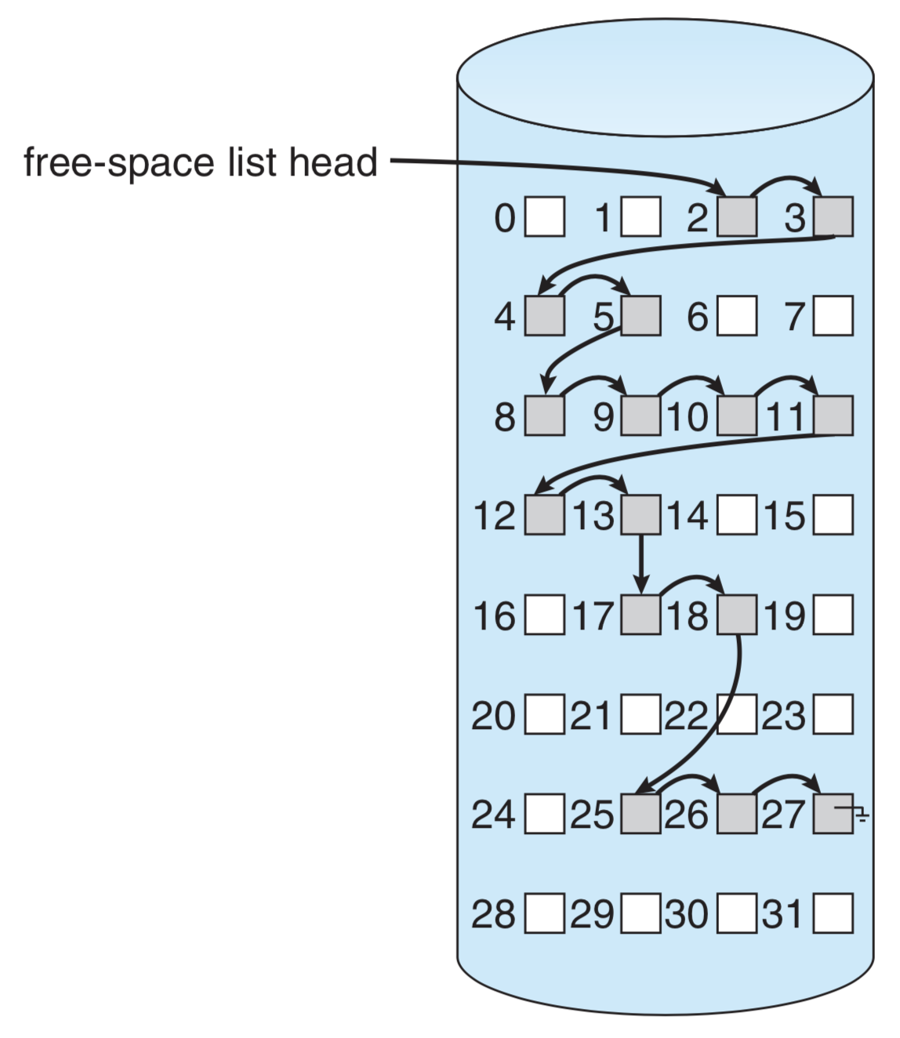
11.5
Free-Space Management
(b) Free list
Free-space list head
Linked list (free list):
  Cannot get contiguous space easily.
  No waste of space.
  No need to traverse the entire list (if # free blocks recorded).
Figure 11.10 Linked free-space list on disk.

Slide 37
11.5
Free-Space Management
(c) Grouping
Modify linked list to store address of next n-1 free blocks in first free block, plus a pointer to next block that contains free-block-pointers (like this one)
Example 14 :
Free-blocks list → 2, 3, 4, 5, 8, 9, 10, 11, 12.
Free-blocks list → 2, 3, 4, 5, 8, 9, 10, 11, 12.
Free-blocks list → 2, 3, 4, 5, 8, 9, 10, 11, 12.
Free-blocks list → 2, 3, 4, 5, 8, 9, 10, 11, 12.
Assume each block can only stores 3 block addresses.
Block 2
Block 5
Block 10
Note: block 2, 5 and 10 have become the index block; cannot be used for Data block
3
4
5
8
9
10
11
12
−

Slide 38
11.5
Free-Space Management
(d) Counting
Because space is frequently contiguously used and freed, with contiguous-allocation algorithms, extents, or clustering:
  Keep address of first free block and count of following free blocks.
  Free space list then has entries containing addresses and counts.

Slide 39
Recovery
11.7
Consistency checking – compares data in directory structure with data blocks on disk, and tries to fix inconsistencies.
  Can be slow and sometimes fails.
Use system programs to backup data from disk to another storage device (magnetic tape, other magnetic disk, optical).
Recover lost file or disk by restoring data from backup.

Slide 40
Summary
11.10
The file system resides permanently on secondary storage → disk.
Physical disks may be segmented into partitions to control media use and to allow multiple file systems.
Any file-system type can have different structures and algorithms.
The various files can be allocated space on the disk in three ways: contiguous, linked, or indexed allocation.

Slide 41
Summary
11.10
Free-space allocation methods also influence the efficiency of disk-space use, the performance of the file system, and the reliability of secondary storage. bit map, linked lists, grouping, and counting.

Slide 42
Exercises
From Silberchatz, Operating System Concepts Chapter 11 Exercises (page: 533 - 534)
11.2
11.7
11.8
11.9
11.10

Slide 43
End of Chapter 11

